Slide 1

Building Machine Learning Models for Apartment Rental Price Prediction
Collaborators: Yara El-Emam ll Zane Huttinga II Kimberly Her II Chinna Maijala
December 16, 2024
University of MN - Data Analytics Bootcamp

Slide 2


Introduction
We analyzed the Apartments for Rent dataset, sourced from the USA classifieds on the UCI Machine Learning Repository. This dataset comprises 100,000 rows and 22 columns, capturing attributes such as price, square footage, location, and other key features. Our objective is to leverage machine learning techniques, including Linear Regression, Neural Networks, and Random Forest, to evaluate model performance and build predictive models that can be applied for future rental price predictions.

Slide 3
Problem Statement
Problem: The apartment rental market is highly dynamic and difficult to predict.
Need: There’s a demand for data-driven insights that can help renters, landlords, and investors make better decisions.

Slide 4
Data Cleaning
Initial Data Cleaning:
Used Apache Spark to load and preprocess the raw data, including removing delimiters, and subsequently loaded the cleaned data into Pandas for further analysis.
Missing values imputation
Used one-hot encoding for categorical variables (e.g., source, category, state).
Mapped boolean columns (e.g., has_photo) to numerical values.
Outlier capping using IQR method
Extracted year and month from the time column.

Slide 5
Data Cleaning
Feature Engineering and Enrichment:
Handled Missing Geographic Data, city name and state columns using reverse geocoding based on latitude and longitude.
Transformed Amenities Column into multiple binary columns (e.g., “Gym, Pool, Parking”) using one-hot encoding.
Final Feature Selection was done using the correlation matrix to identify features that strongly correlate with price.

Slide 6
Machine Learning

Slide 7
Preprocessing for Machine Learning
Encoding: Applied one-hot encoding to categorical variables
Scaling: Standardized numerical features such as price, square feet, bathrooms, etc., to ensure uniform scaling.
Splitting: Divided the dataset into training (80%) and testing (20%) sets for robust model evaluation.

Slide 8
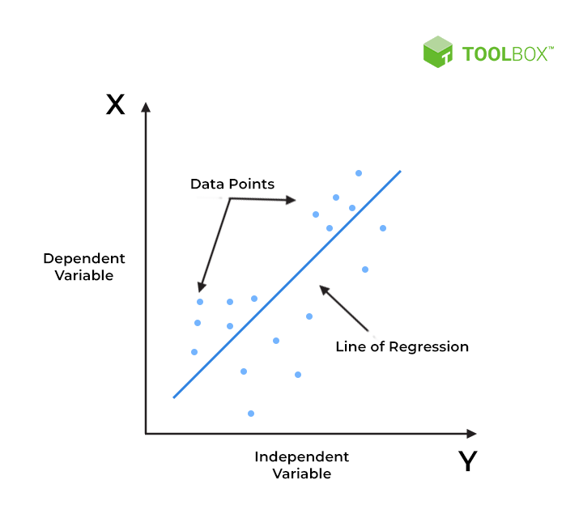
Linear Regression
01
Overview
Performed using Scikit-learn’s LinearRegression function.
Fitted to scaled training data (X) and training data (y).
Results:
MSE: 370,387.31
R-squared: 0.4437 44.37%
QUICK TIP
Try rightclicking on a photo and using "Replace Image" to show your own photo.
Source: Spiceworks.com

Slide 9
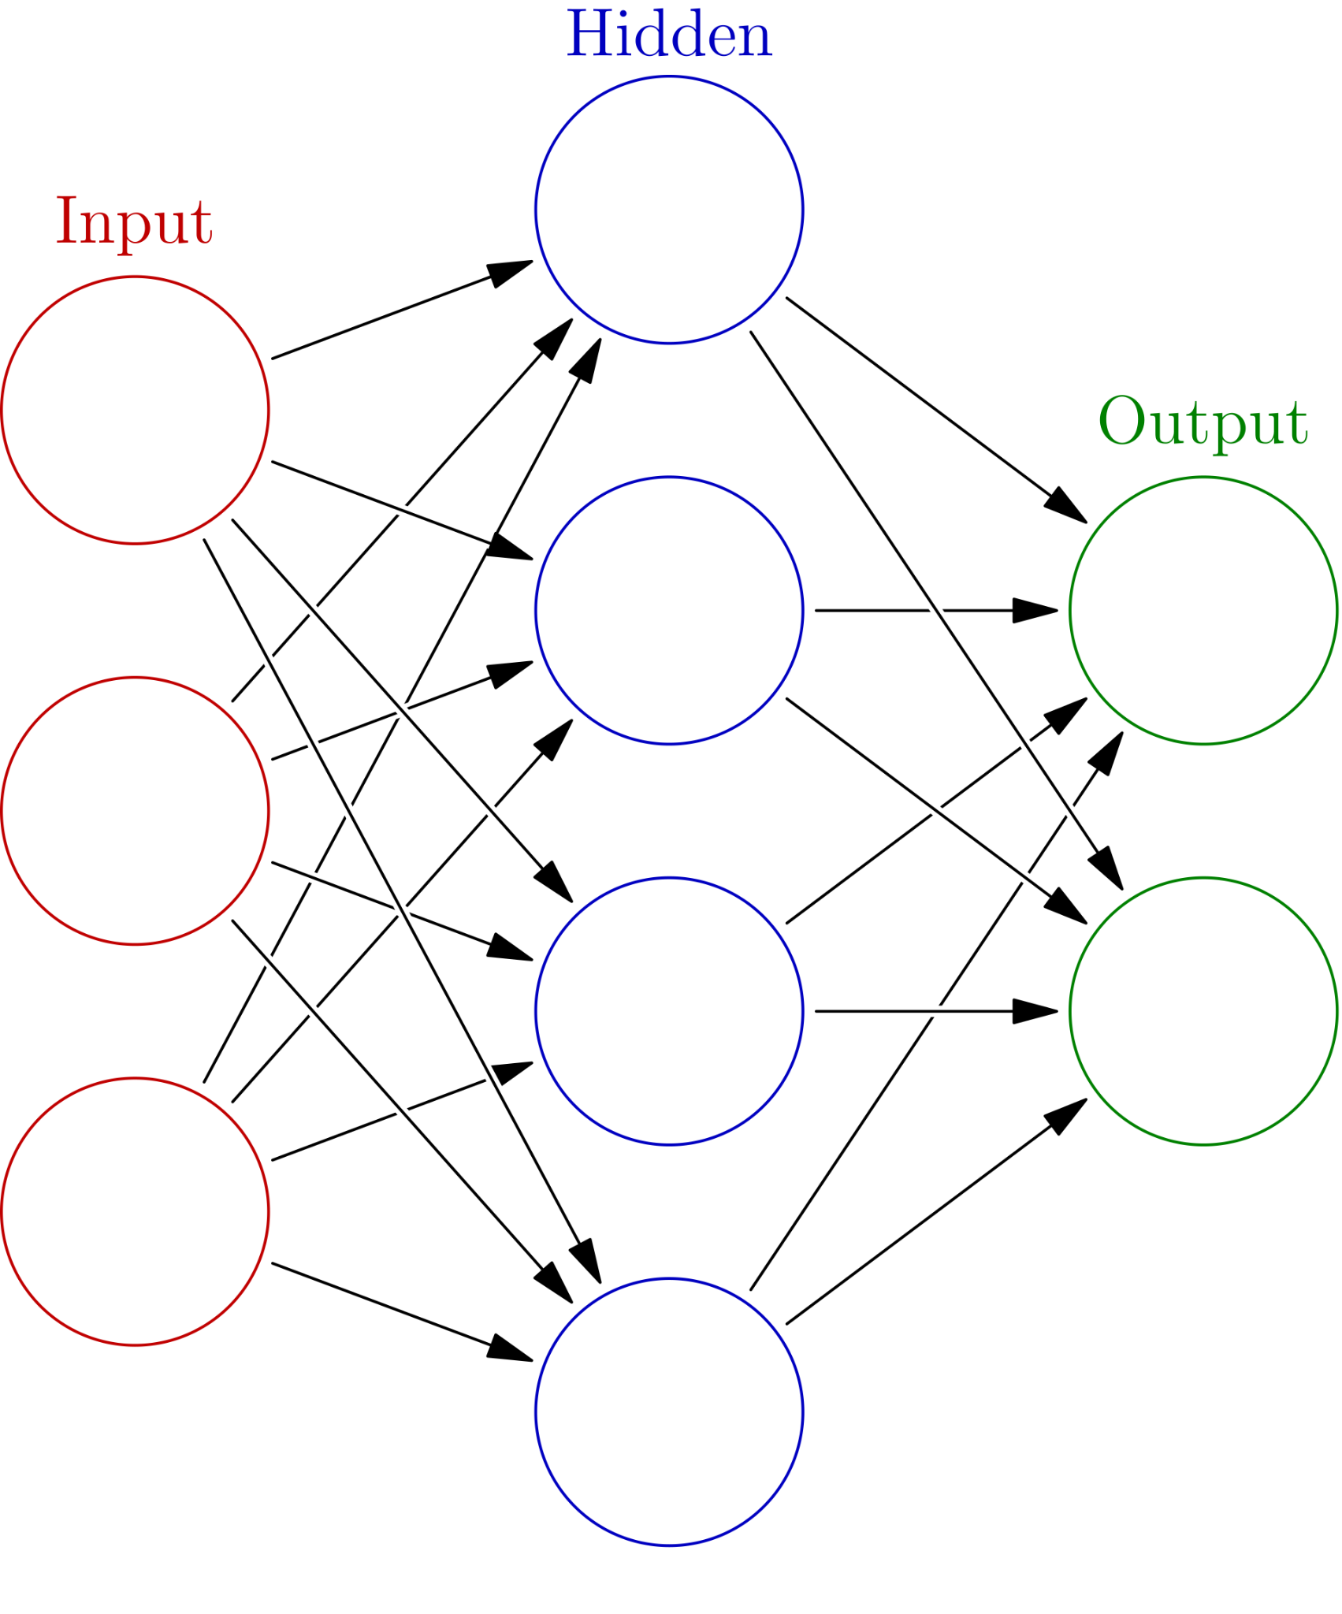
Neural Networks
02
Enhanced model architecture:
256 neurons in the input layer,
Dropout layers to prevent overfitting
Batch normalization for improved stability
This model demonstrated moderate performance
Results:
MSE: 295,780.94
R-squared: 0.6444 (64.44%)
Optimized model architecture:
Additional regularization techniques (e.g., L2 regularization),
Optimized learning rate, and
More targeted dropout rates.
Results:
MSE: 322,983.44
R-squared: 0.6117 (61.17%)
Source: Wikipedia user Glosser.ca

Slide 10
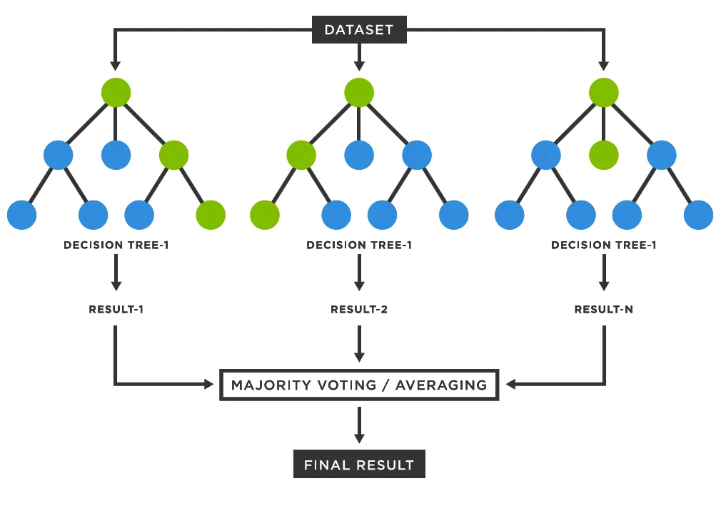
Random Forest Regressor
03
Initial run architecture:
Used the default parameters of the Random Forest Regressor:
Number of Estimators (n_estimators): 100
Maximum Depth (max_depth): None (the tree expands until all leaves are pure or contain less than min_samples_split samples)
Results:
MSE: 129,886.13
R-squared: 0.8049 (80.49%)
Fine-tuned run architecture:
n_estimators: Number of trees in the forest.
max_depth: Maximum depth of each tree.
min_samples_split: Minimum number of samples required to split a node.
min_samples_leaf: Minimum number of samples required in a leaf node.
max_features: Number of features to consider when looking for the best split.
Results:
MSE: 129,631.31
R-squared: 0.8053 (80.53%)
Source: Medium.com (user Deniz Gunay)

Slide 11
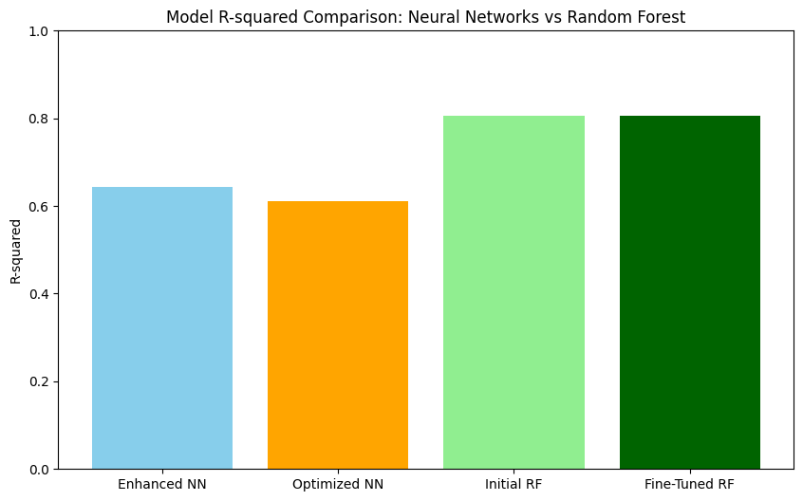
Visualizations - Key Insights
Key Trends: Use Matplotlib

Slide 12






Results & Insights
Model Performance:
Achieved an R-squared of 80.53% with a fine-tuned Random Forest model.
Demonstrated the importance of enriched and consistent data for predictive accuracy.
Impact of Data Enrichment:
Addressing missing geographic information and encoding text-based features enhanced the dataset significantly.
Improved feature space enabled models to leverage granular information, leading to better predictions.

Slide 13
Conclusion
Successfully demonstrated the importance of data enrichment and optimization in machine learning.
By addressing missing geographic information, encoding amenities, and ensuring consistency, we enhanced the dataset to provide valuable insights for predicting apartment rental prices.
The fine-tuned Random Forest model achieved an R-squared of over 80%, showcasing strong predictive power.

Slide 14
Challenges, Limitations, & Opportunities
Challenges
Handling missing values in the city name and state columns by using reverse geocoding to fill in missing data added computational complexity and increased processing time.
Limitations
While the enriched data improved model performance, the models do not account for trends or market fluctuations over time. Incorporating temporal data could help identify seasonal patterns and enhance predictions.
Opportunities
Future work could explore clustering techniques to identify apartment types or rental categories. For a deeper insight, we could also investigate key factors that affect rent, such as location and amenities.
01
03
02

Slide 15
Supplementary Models
LightGBM Results:
Mean Squared Error (MSE): 170,490.74
R-squared: 0.7439 (74.39%)
CatBoost Results:
Mean Squared Error (MSE): 191,902.68
R-squared: 0.7118 (71.18%)
Insights from Exploration:
Random Forest outperformed both LightGBM and CatBoost, delivering the best results.
Random Forest is robust and handles nonlinear relationships effectively.
The study highlights the importance of testing multiple models to validate performance.

Slide 16
Real-World Applications of the Model
Rental Price Estimation for Tenants:
The trained model demonstrates strong predictive power, serving as the foundation for systems that estimate rental prices.
Dynamic Pricing for Property Owners:
With further deployment, landlords could use the model to adjust rental prices dynamically.
Guidance for Real Estate Investors:
The model can help investors evaluate potential properties by predicting rental returns, once integrated into an application.
Next Steps for Real-World Use:
Deploy the model as an API or integrate it into platforms for predictions.
Build input pipelines to preprocess real-world data before predictions.
Monitor and update the model regularly to maintain accuracy.

Slide 17
Thank You.
Questions?

Slide 18
Sources of the dataset: USA classifieds on the UCI Machine Learning Repository
Technologies Used:
- Programming Language: Python
- Python Libraries: Pandas, NumPy, Matplotlib, Scikit-learn.
- Data processing: Apache Spark for data retrieval and preprocessing
- Machine Learning Frameworks: Scikit-learn for model development, training and evaluation
- Visualization: Matplotlib for data exploration and results visualization
References

